Slide 1
Deployment Process
Allyis apps
10/1/2015

Slide 2
The Easy Way pt. 1
Code changes

Slide 3
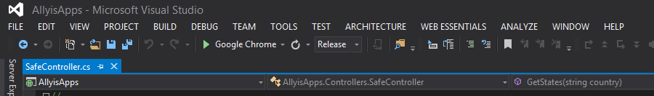
Select the build ‘Release’

Slide 4
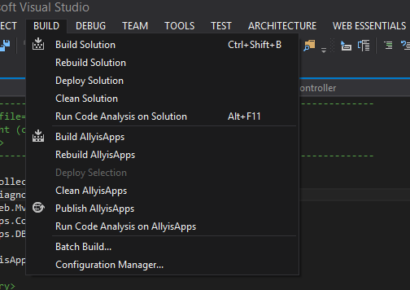
Click Build > Publish AllyisApps
If this option is not selectable, you may need to open any file from the AllyisApps or AllyisApps.DBModel projects.

Slide 5
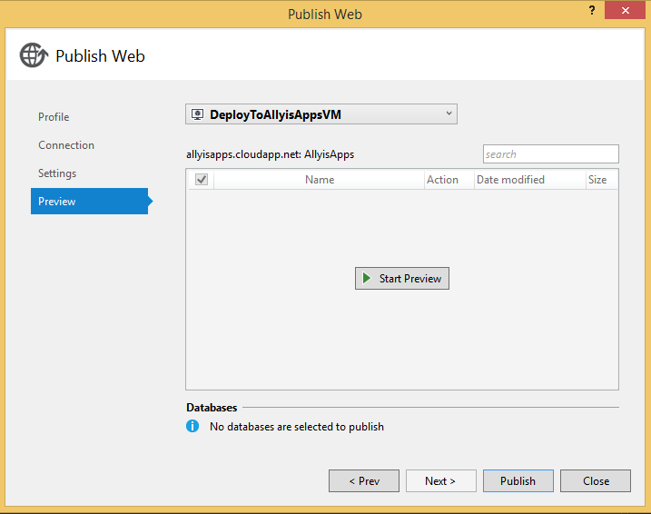
Ensure ‘DeployToAllyisAppsVM’ profile is selected, and click Publish.
If prompted for a password, use ScreenShot2015$.

Slide 6
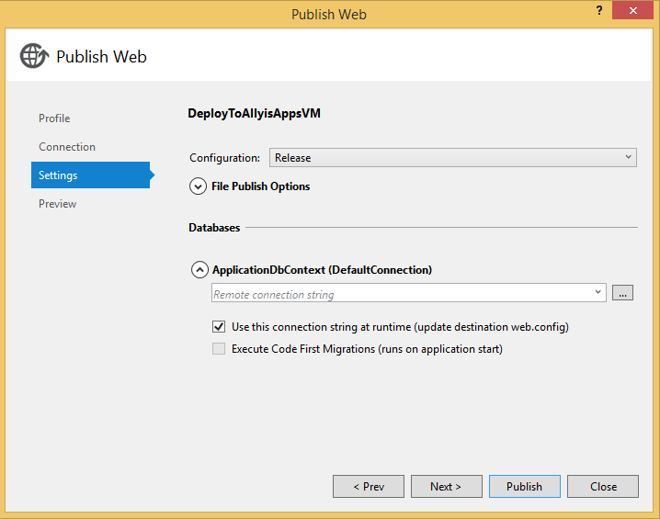
Notes
This will only push code changes from the solution. No database changes will be pushed by doing this. I believe you can set it up by changing the ApplicationDbContext field in Settings for the publish profile.

Slide 7
Notes
Incase the DeployToAllyisAppsVM profile is not on your machine or a part of your project, below are the settings:
Publish Method: Web Deploy
Server: allyisapps.cloudapp.net
Site name: AllyisApps
User name: ALLYISAPPS\aauser
Password: ScreenShot2015$
If the VM has to restart for an update or for any other reason, it is possible for the web deployment services to stop working properly. If this happens, restarting the following services should get everything working again: msdepsvc & wmsvc.

Slide 8
The Easy Way pt. 2
Database changes

Slide 9
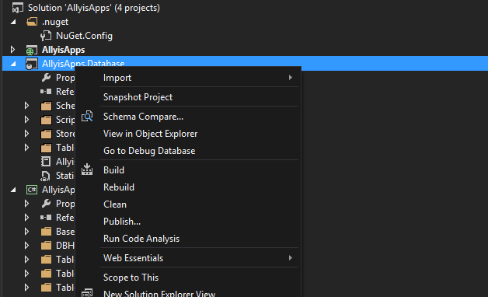
Right-click AllyisApps.Database from the SolutionExplorer and select Schema Compare.

Slide 10
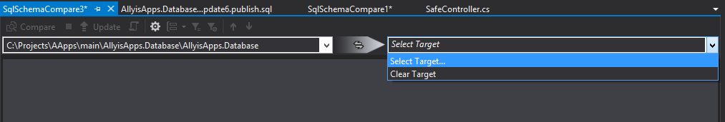
In the following screen, select ‘Select Target’ from the right dropdown.

Slide 11
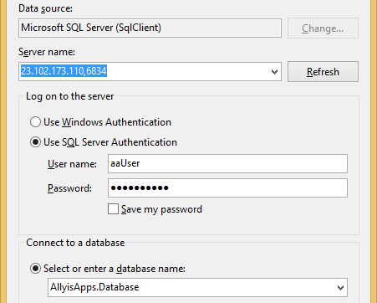
Click ‘New Connection’, and create one with these settings.
Server name: 23.102.173.110,6834
Use SQL Server Authentication
User name
aaUser
Password
BlueSky23#
Database Name: AllyisApps.Database

Slide 12
Once the you are connected, click ‘Compare’

Slide 13
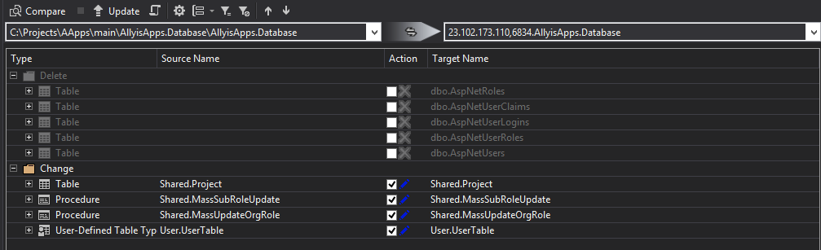
Once the comparision is complete, confirm any changes you wish to push and click ‘Update’.

Slide 14
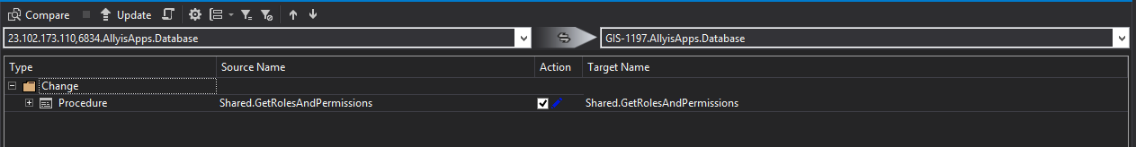
Note: If you wish to create a revert script…
Ensure that your local database is the same as the project. Delete your local database and publish from VS if you need to make sure.
Open Schema compare, and in the left source dropdown, select the VM database. In the target on the right, select your local database.
Clicking the ‘Generate Scripts’ icon will create a reversion script. In the event an error occurs, you can run this script to reverse any changes.

Slide 15
The Hard Way
Go no further…..

Slide 16
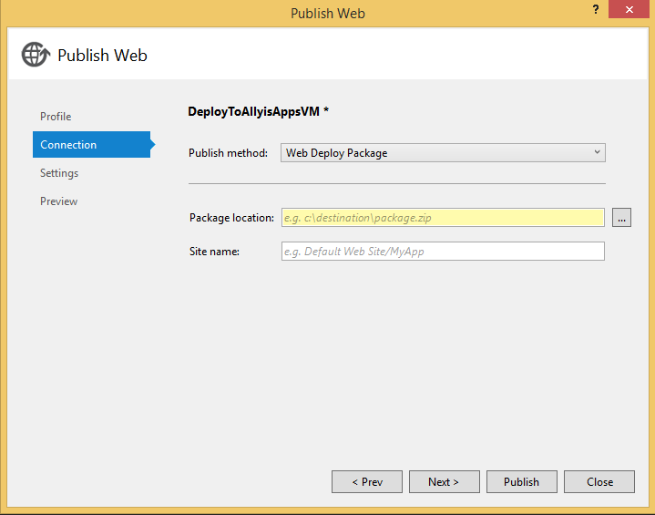
On Your Local Machine…
Follow The Easy Way, however instead of using the DeployToAllyisAppsVM profile, click Connection and change Publish method to Web Deploy Package, fill out the package location, and click Publish.

Slide 17
Access the Virtual Machine
Logging in to https://manage.windowsazure.com with your Allyis account will display the Azure control panel. (If it does not, consult your manager.)
On the left side, you will see a list of different types of products you can use on Azure.
On the next slide, you will see that we have selected Virtual Machines and have two in our subscription: allyisapps (for hosting the application) and allyissvn (for hosting the source control).
Clicking ‘Connect’ at the bottom will download a rdp file for accessing the VM.
User Name: aauser
Password: ScreenShot2015$

Slide 18
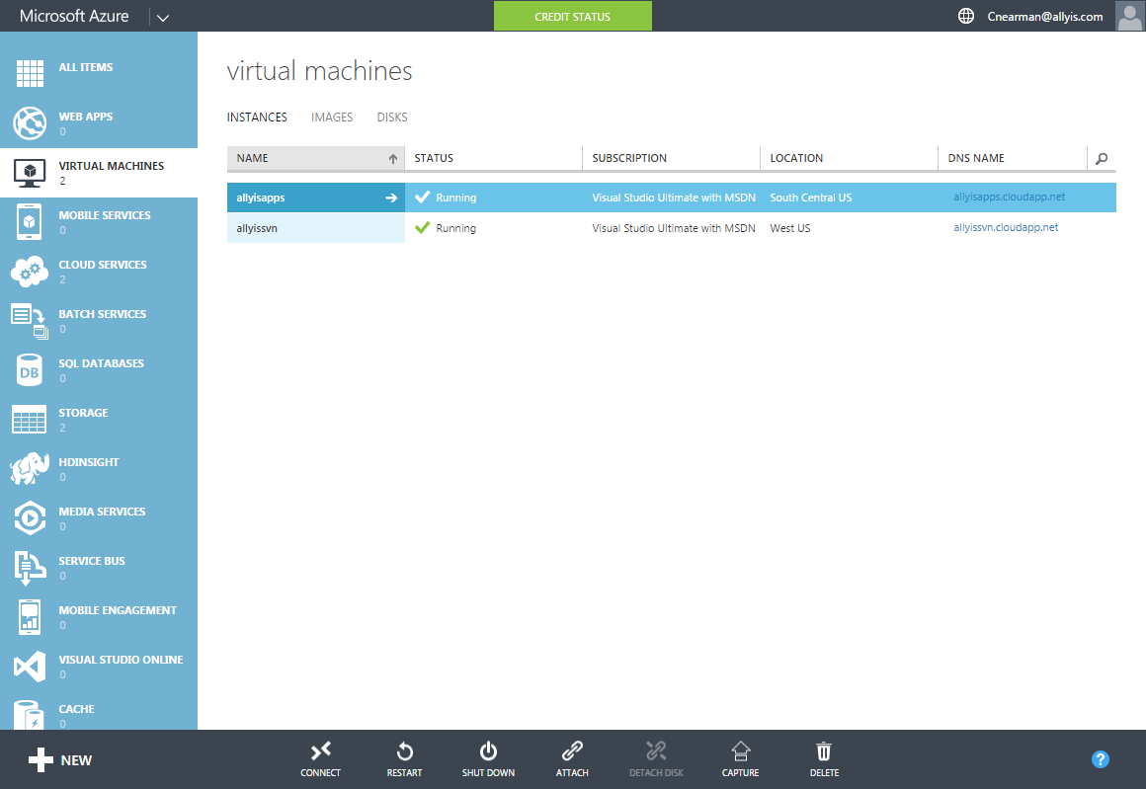

Slide 19
Access the Virtual Machine, cont.
You can adjust the settings you use to remote desktop to the VM by right clicking on the .rdp file and selecting ‘Edit’.
On the Local Resources tab, you can enable the VM to access files on your local machine by clicking ‘More’, and then checking the box for ‘Drives’.

Slide 20
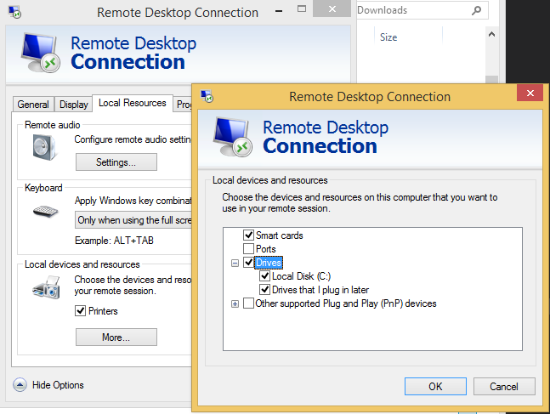
Access the Virtual Machine, cont.

Slide 21
On The Virtual Machine
Navigate to the directory on your local drive where you created the deployment package.
Extract the package and copy the contents of the Content\C_C\Projects\AApps\main\AllyisApps\obj\Release\Package\PackageTmp\ folder to C:\inetpub\allyisapps\AllyisApps_deploy.

Slide 22
The Hard Way pt.2
Turn back….. Really

Slide 23
Really, don’t do this
Find out what queries and tables have changed since your last deployment (I suggest tracking commits).
Manually update those queries and tables in SMSS.
If a table needs to be updated, use the table designer in SMSS.

Slide 24
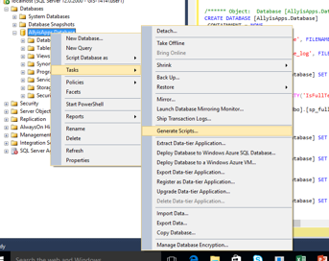
Troubleshooting some common issues
In case schema update is not able to compare , or update successfully:
Delete allyisapps database at VM, create new database with the same name and default settings.
Generate script for allyisapps Database at local. Select schema
And data at the advanced Options you’ll find a few steps
Down while navigating.
Copy all to clipboard except initial few lines
about creating database, since you’ve already done
that at the apt location in the previous step.
Paste in VM database. Itll help to wait a minute if ctrl V
doesn’t work immediately. Run the command!

